Slide 1
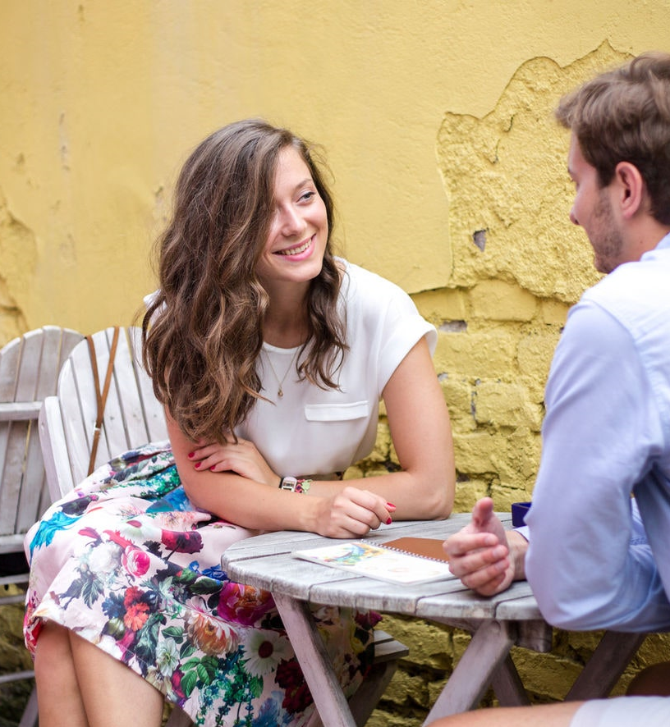
Let’s Go Out!
Gone are the days of arguing over what to do on date night. Have Let’s Go Out pick the perfect date for you and your significant other!
Anthony Snyder

Slide 2
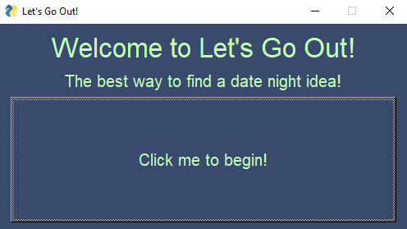
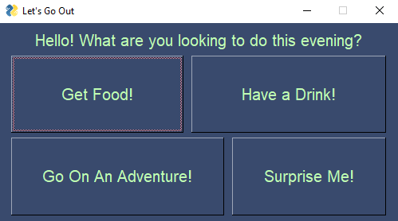
Introduction
Overview
Simplify date night
App layout
Welcome Screen
Main Screen

Slide 3
Tutorials
CalcGUI Demo
PySimpleGUI
https://pysimplegui.readthedocs.io/en/latest/
Excel reference
https://pythonbasics.org/read-excel/
Brewery DB
https://github.com/ksu-is/Brewery-DB

Slide 4
Development
API to CSV
Trouble with reading random lines

Slide 5

Show Code

Slide 6
What Next?
Clickable menu link
Refine GUI

